Slide 1
Term Deposit(Logistic Regression)
Group 10
Ayushi Agarwal 12
Jay Mehta 18
Sarandha Gupta 45
Tanvi Dabir 55

Slide 2
About the case
Our client is a retail banking institution.
Major source of income for the bank is term deposits.
The customers may or may not subscribe to these term deposits, this highly depends on marketing campaigns.
The bank has various outreach plans to sell term deposits to their customers such as email marketing, advertisements, telephonic marketing and digital marketing.
Our client wants to understand beforehand whether a sample of people will subscribe to term deposits or not based on telephonic campaigns.

Slide 3
About the case
Input files:-
train.csv : Use this dataset to train the model. This file contains all the client and call details as well as the target variable“subscribed”. You have to train your model using this file.
test.csv : Use the trained model to predict whether a new set of clients will subscribe the term deposit.
Dependent variable - Subscribed

Slide 4
STEPS
Importing libraries and Dataset
EDA, Visualization
Logistic model building
Checking model Accuracy

Slide 5
Lets begin coding

Slide 6
STEP 1
Importing libraries and dataset

Slide 7
Importing libraries & Dataset
Libraries-
matplotlib.pyplot
NumPy
Pandas
Seaborn
Sklearn , logistic regression
Dataset-
Importing train dataset in df_train and test dataset in df_test variable.

Slide 8
STEP 2
EDA & Visualization

Slide 9
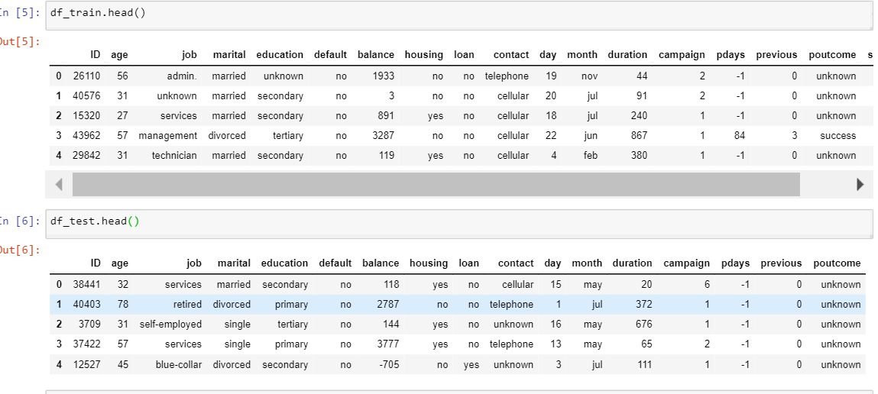
Exploring the datasets

Slide 10
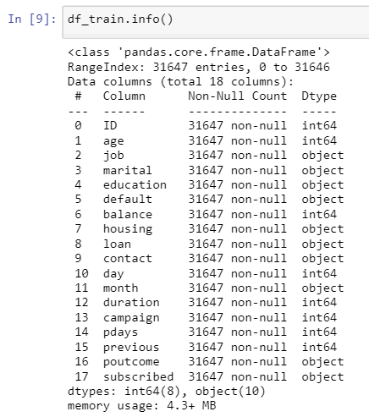
Understanding dataset
Dependent variable - subscribed

Slide 11
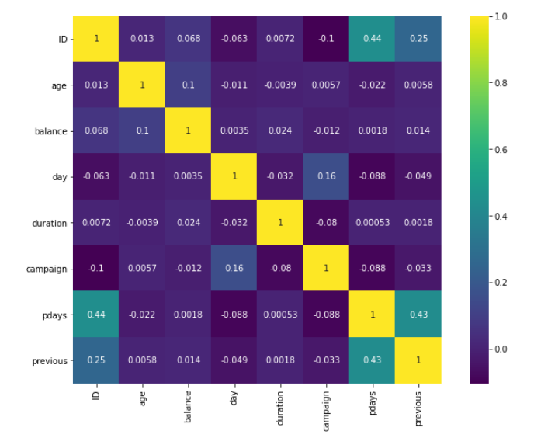
Heatmap
To check Correlation between the numeric variables of the train dataset

Slide 12
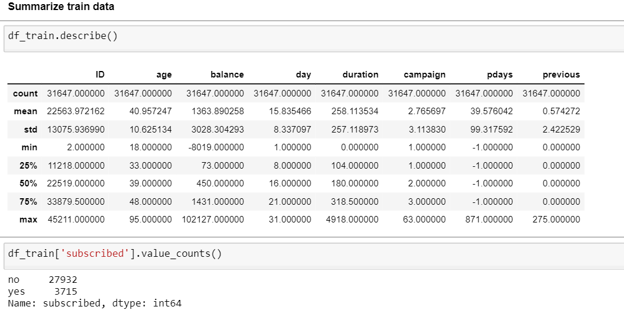

Slide 13
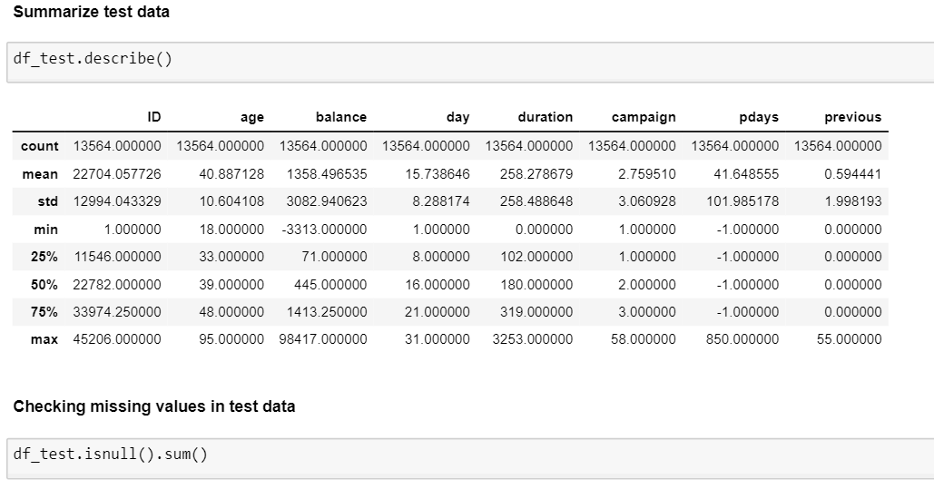

Slide 14
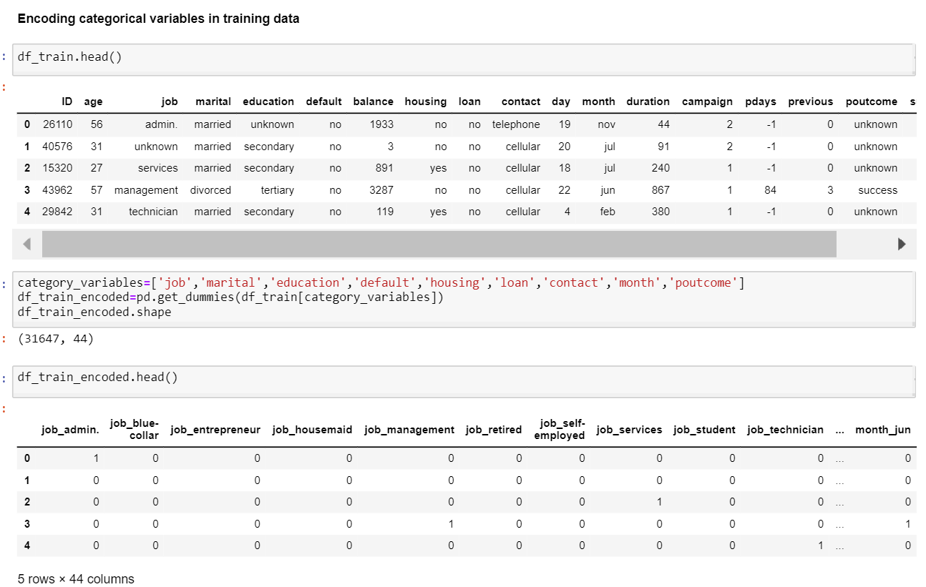

Slide 15
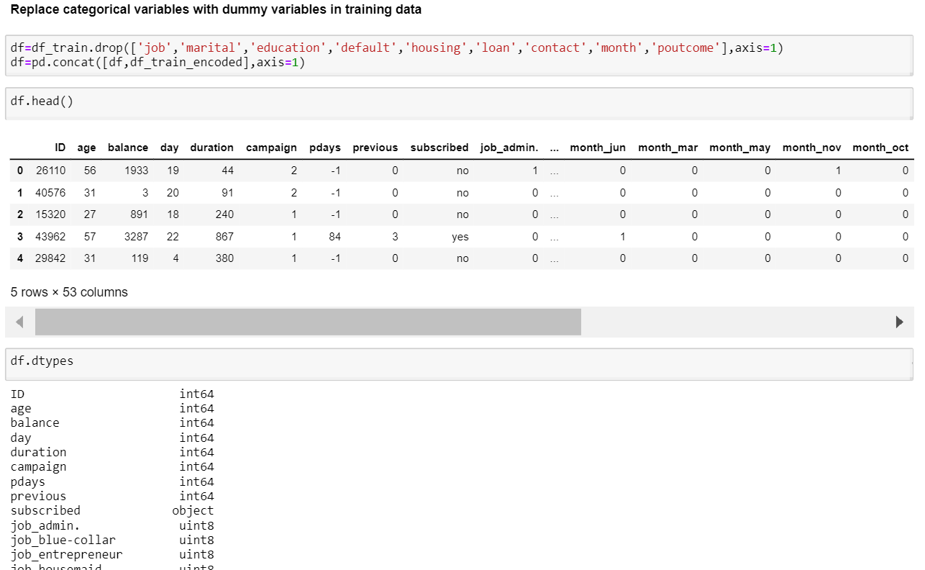

Slide 16
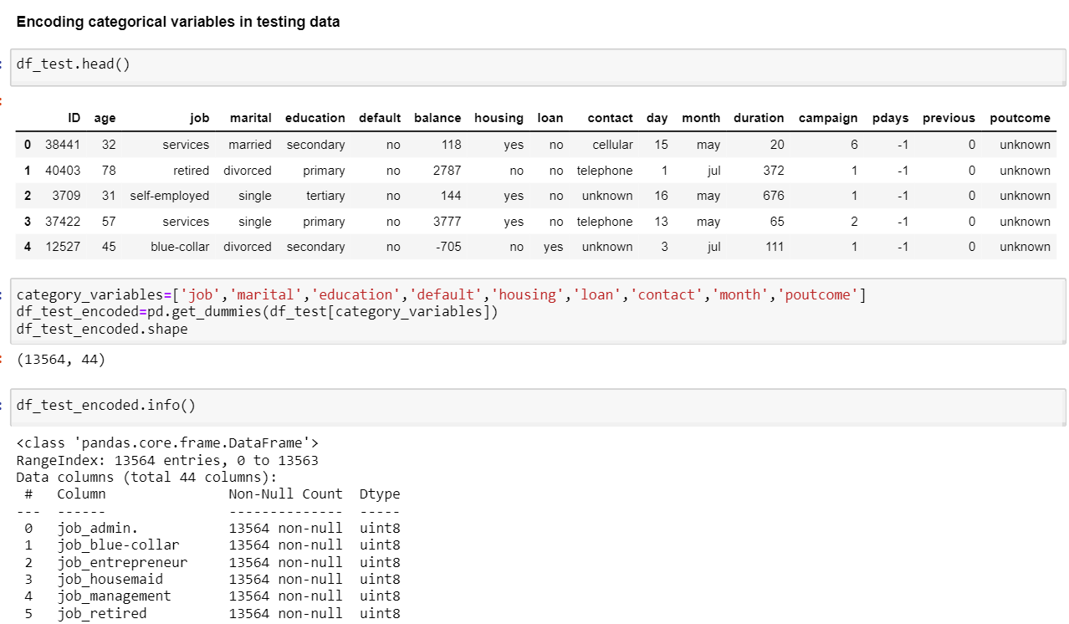

Slide 17
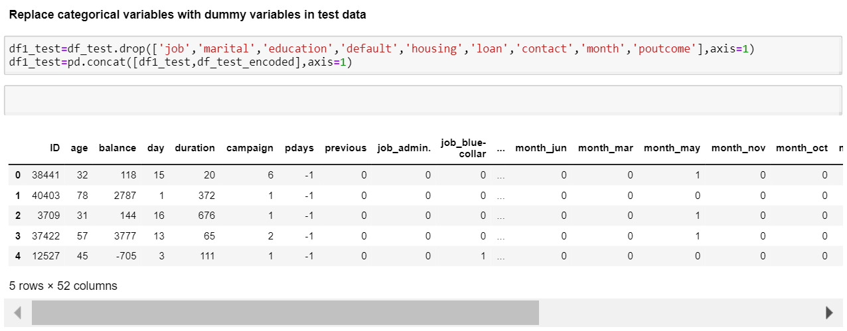

Slide 18
STEP 3
Logistic model Building

Slide 19
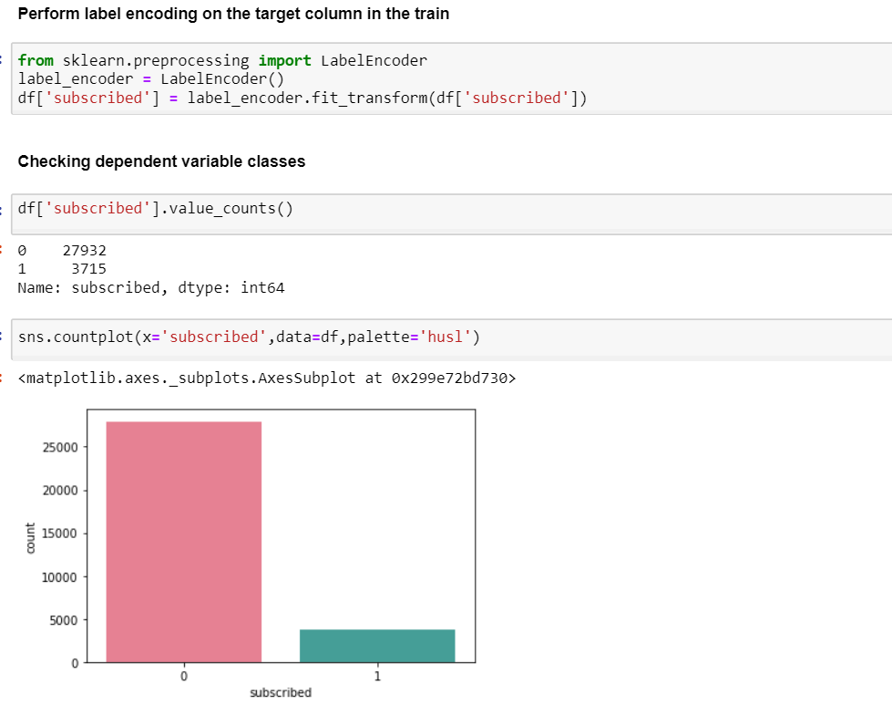
This is indicating highly imbalanced data.
Before building model we need to solve this issue.

Slide 20
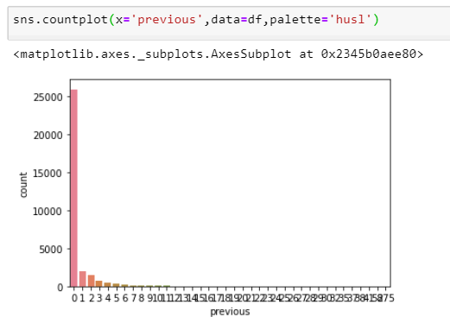
Mostly no previous communication campaigns were made

Slide 21
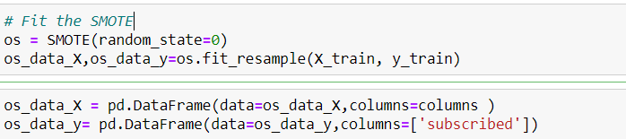
Performed smote to carry out oversampling
length of oversampled data is 39160
Number of no subscription in oversampled data 19580
Number of subscription 19580
Proportion of no subscription data in oversampled data is 0.5
Proportion of subscription data in oversampled data is 0.5

Slide 22
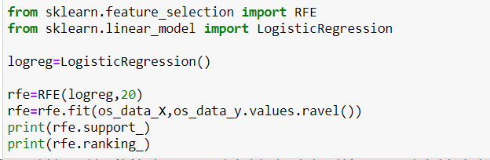
Performed feature engineering
The RFE has helped us to select the following features:'previous', 'subscribed', 'job_admin.', 'job_blue-collar','job_entrepreneur', 'job_housemaid', 'job_management','job_retired', 'job_self-employed', 'job_services', 'job_student','job_technician', 'job_unemployed', 'job_unknown','marital_divorced', 'marital_married', 'marital_single','education_primary', 'education_secondary', 'default_no', 'default_yes'

Slide 23
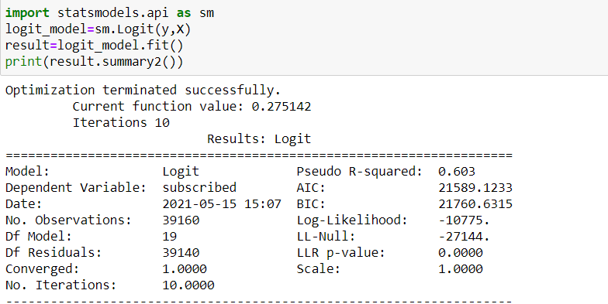
Implementation of model
p-values for all of the variables are smaller than 0.05.
Hence we can consider these variables for our model.

Slide 24

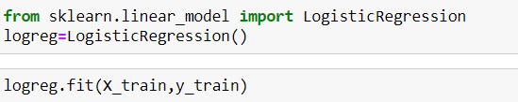
Again splitting the training data set with desired features
Further building logistic regresssion
Next we will analyze metrics for the built model

Slide 25
STEP 4
Checking model accuracy

Slide 26
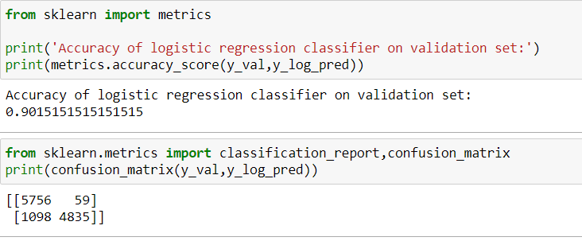
Accuracy and Confusion Matrix
Accuracy achieved is 90% by our model
Confusion matrix indicates, model has predicted True positive and False positive correct to a great extent.

Slide 27
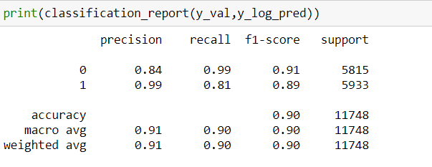
Classification report
Precision and recall values for for subscribed as well as non- subscribed are more than 85%.
Hence, model seems reliable

Slide 28
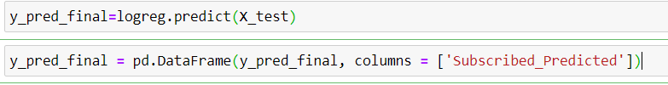
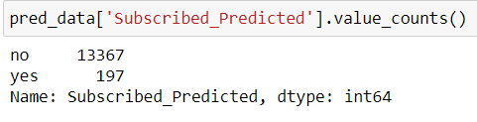
Predicting the values in the test file
Predicting given test excel file and finding the number of would be subscribers and non subscribers.

Slide 29
CONCLUSION

Slide 30
Conclusion & Business Implication
Our model is predicting how many number of clients will subscribe to term deposit through telephonic marketing campaign.
The model is predicting the number of subscribed and not subscribed correctly as the accuracy is 90%.
The results are-
13367 clients will not subscribe to term deposit
197 clients will subscribe to term deposit

Slide 31
Github Links
Ayushi Agarwal
https://github.com/Ayushi349
Jay Mehta
https://github.com/Jay-Mehta-RBA/Jay-Mehta.git
Sarandha Gupta
https://github.com/isarandhagupta/isarandhagupta.github.io
Tanvi Dabir
https://github.com/Tanvi048/PythonProject

Slide 32
Thank You

